Slide 1

Go, change the world
RV College of
Engineering
PARTICULATE TECHNOLOGY
Course Coordinator
Dr. Vidya C
Department of Chemical Engg, RVCE
vidyac@rvce.edu.in
Mob No:9620166222

Slide 2

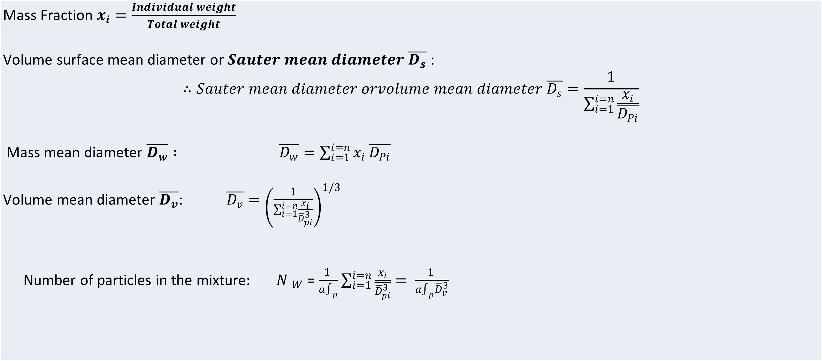
RV College of
Engineering
Go, change the world
Average Particle Size
Mass Fraction $x_{i}=\frac{Individual weight}{Total weight}$ Volume surface mean diameter or $Sauter mean diameter$ $\overline{D_{s}}$ : $$∴Sauter mean diameter orvolume mean diameter \overline{D_{s}}=\frac{1}{\sum_{i=1}^{i=n}{\frac{x_{i}}{\overline{D_{Pi}}}}}$$ Mass mean diameter $\overline{D_{w}} : \overline{D_{w}}=\sum_{i=1}^{i=n}{x_{i}}\overline{D_{Pi}}$ Volume mean diameter $\overline{D_{v}}$: $\overline{D_{v}}={\left(\frac{1}{\sum_{i=1}^{i=n}{\frac{x_{i}}{{\overline{D}}_{pi}^{3}}}}\right)}^{1/3}$ Number of particles in the mixture: ${N }_{W}$= $\frac{1 }{a∫_{p}}\sum_{i=1}^{i=n}{\frac{x_{i}}{\overline{{\overline{D}}_{pi}^{3}}}= \frac{1 }{a∫_{p}{\overline{D}}_{v}^{3}}}$

Slide 3
RV College of
Engineering
Go, change the world
Pb 1. Determine the Volume surface mean diameter, Volume mean diameter, specific surface area of a given powder sample using the data given in table. Density of particle is 2650 kg/m3 and sphericity is 0.7
Mesh No. | - | 4/6 | 6/8 | 8/10 | 10/14 | 14/20 | 20/28 | 28/35 | 35/48 | 48/65 | -65
Screen opening Dpi, mm | 4.699 | 3.327 | 2.362 | 1.651 | 1.168 | 0.833 | 0.589 | 0.417 | 0.295 | 0.208 | 0.208
Mass fraction retained | - | 0.031 | 0.103 | 0.200 | 0.186 | 0.152 | 0.120 | 0.095 | 0.065 | 0.043 | 0.005

Slide 4
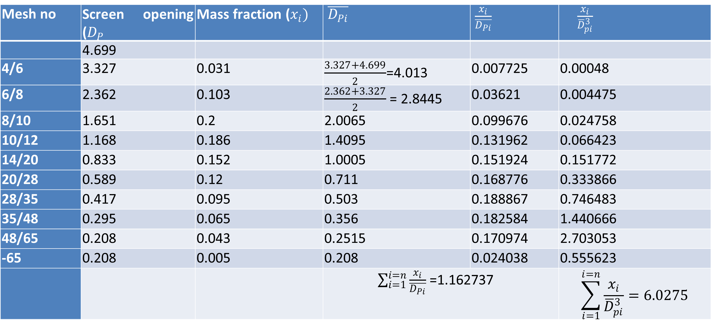
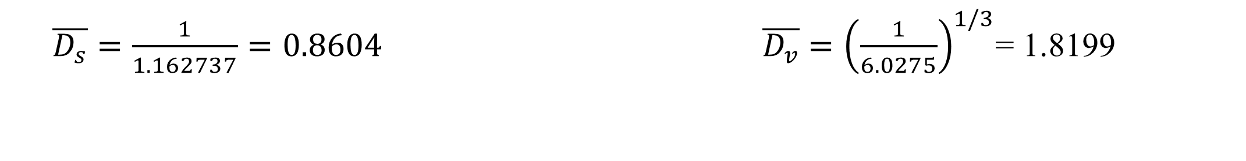
RV College of
Engineering
Go, change the world
Solution
Mesh no | Screen opening ($D_{P}$ | Mass fraction ($x_{i})$ | $\overline{D_{Pi}}$ | $\frac{x_{i}}{\overline{D_{Pi}}}$ | $\frac{x_{i}}{{\overline{D}}_{pi}^{3}}$
 | 4.699
4/6 | 3.327 | 0.031 | $\frac{3.327+4.699}{2}$=4.013 | 0.007725 | 0.00048
6/8 | 2.362 | 0.103 | $\frac{2.362+3.327}{2}$ = 2.8445 | 0.03621 | 0.004475
8/10 | 1.651 | 0.2 | 2.0065 | 0.099676 | 0.024758
10/12 | 1.168 | 0.186 | 1.4095 | 0.131962 | 0.066423
14/20 | 0.833 | 0.152 | 1.0005 | 0.151924 | 0.151772
20/28 | 0.589 | 0.12 | 0.711 | 0.168776 | 0.333866
28/35 | 0.417 | 0.095 | 0.503 | 0.188867 | 0.746483
35/48 | 0.295 | 0.065 | 0.356 | 0.182584 | 1.440666
48/65 | 0.208 | 0.043 | 0.2515 | 0.170974 | 2.703053
-65 | 0.208 | 0.005 | 0.208 | 0.024038 | 0.555623
 |  |  | $\sum_{i=1}^{i=n}{\frac{x_{i}}{\overline{D_{Pi}}}}$ =1.162737 |  | $$\sum_{i=1}^{i=n}{\frac{x_{i}}{{\overline{D}}_{pi}^{3}}}=6.0275$$
$\overline{D_{s}}=\frac{1}{1.162737}=0.8604 \overline{D_{v}}={\left(\frac{1}{6.0275}\right)}^{1/3}$= 1.8199

Slide 5
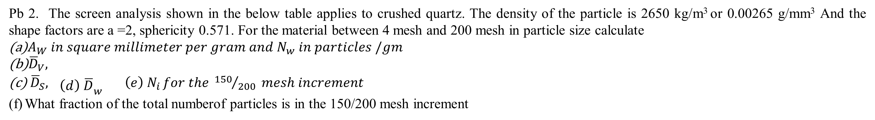
RV College of
Engineering
Go, change the world
Pb 2. The screen analysis shown in the below table applies to crushed quartz. The density of the particle is 2650 kg/m³ or 0.00265 g/mm³ And the shape factors are a =2, sphericity 0.571. For the material between 4 mesh and 200 mesh in particle size calculate
$A_{W} in square millimeter per gram and N_{w} in particles /gm$
${\overline{D}}_{V},$
${\overline{D}}_{S}, {\begin{aligned} \\ \left(d\right) \overline{D}\end{aligned}}_{w} \left(e\right) N_{i }for the {150}/{200} mesh increment$
What fraction of the total numberof particles is in the 150/200 mesh increment
Mesh | Screen Opening | Mass fraction retained
4 | 4.699 | 0
6 | 3.327 | 0.0251
8 | 2.362 | 0.125
10 | 1.651 | 0.3207
14 | 1.168 | 0.257
20 | 0.833 | 0.159
28 | 0.589 | 0.0538
35 | 0.417 | 0.021
48 | 0.295 | 0.0102
65 | 0.208 | 0.0077
100 | 0.147 | 0.0058
150 | 0.104 | 0.0041
200 | 0.074 | 0.0031
Pan |  | 0.0075

Slide 6
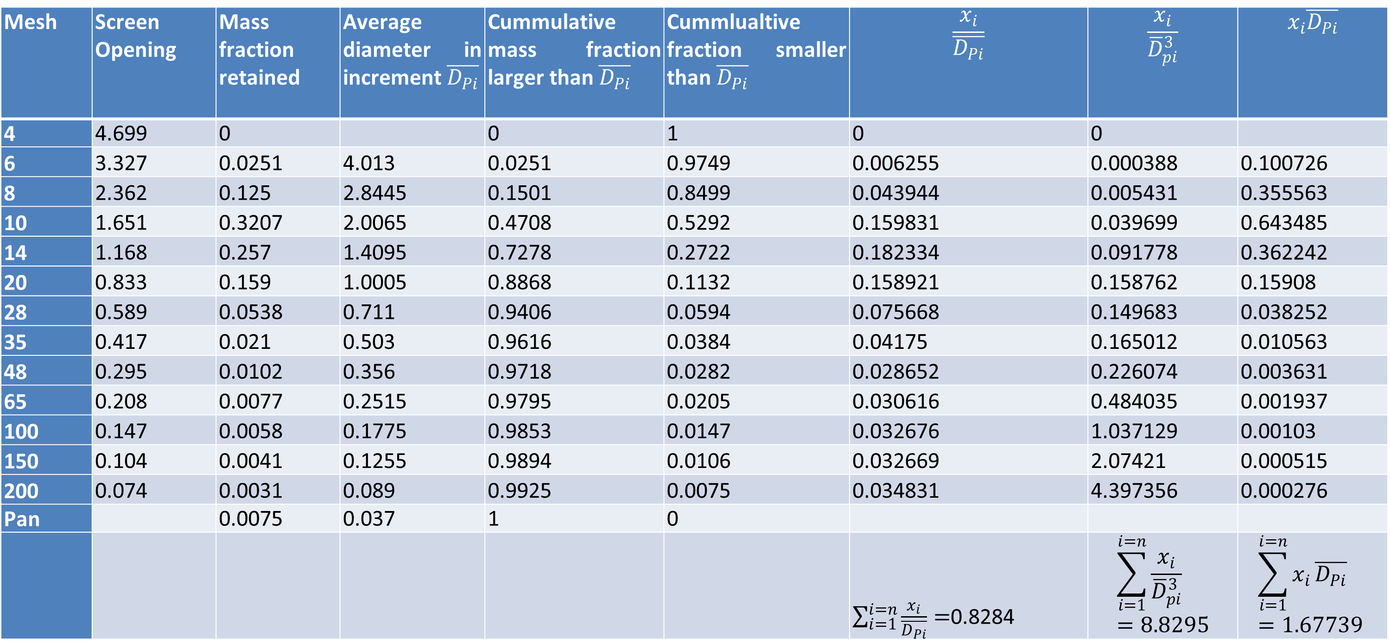
RV College of
Engineering
Go, change the world
Solution
Mesh | Screen Opening | Mass fraction retained | Average diameter in increment $\overline{D_{Pi}}$ | Cummulative mass fraction larger than $\overline{D_{Pi}}$ | Cummlualtive fraction smaller than $\overline{D_{Pi}}$ | $$\frac{x_{i}}{\overline{D_{Pi}}}$$ | $$\frac{x_{i}}{{\overline{D}}_{pi}^{3}}$$ | $$x_{i}\overline{D_{Pi}}$$
4 | 4.699 | 0 |  | 0 | 1 | 0 | 0
6 | 3.327 | 0.0251 | 4.013 | 0.0251 | 0.9749 | 0.006255 | 0.000388 | 0.100726
8 | 2.362 | 0.125 | 2.8445 | 0.1501 | 0.8499 | 0.043944 | 0.005431 | 0.355563
10 | 1.651 | 0.3207 | 2.0065 | 0.4708 | 0.5292 | 0.159831 | 0.039699 | 0.643485
14 | 1.168 | 0.257 | 1.4095 | 0.7278 | 0.2722 | 0.182334 | 0.091778 | 0.362242
20 | 0.833 | 0.159 | 1.0005 | 0.8868 | 0.1132 | 0.158921 | 0.158762 | 0.15908
28 | 0.589 | 0.0538 | 0.711 | 0.9406 | 0.0594 | 0.075668 | 0.149683 | 0.038252
35 | 0.417 | 0.021 | 0.503 | 0.9616 | 0.0384 | 0.04175 | 0.165012 | 0.010563
48 | 0.295 | 0.0102 | 0.356 | 0.9718 | 0.0282 | 0.028652 | 0.226074 | 0.003631
65 | 0.208 | 0.0077 | 0.2515 | 0.9795 | 0.0205 | 0.030616 | 0.484035 | 0.001937
100 | 0.147 | 0.0058 | 0.1775 | 0.9853 | 0.0147 | 0.032676 | 1.037129 | 0.00103
150 | 0.104 | 0.0041 | 0.1255 | 0.9894 | 0.0106 | 0.032669 | 2.07421 | 0.000515
200 | 0.074 | 0.0031 | 0.089 | 0.9925 | 0.0075 | 0.034831 | 4.397356 | 0.000276
Pan |  | 0.0075 | 0.037 | 1 | 0
 |  |  |  |  |  | $\sum_{i=1}^{i=n}{\frac{x_{i}}{\overline{D_{Pi}}}}=$0.8284 | $$\sum_{i=1}^{i=n}{\frac{x_{i}}{{\overline{D}}_{pi}^{3}}}=8.8295$$ | $$\sum_{i=1}^{i=n}{x_{i}}\overline{D_{Pi}}=1.67739$$

Slide 7
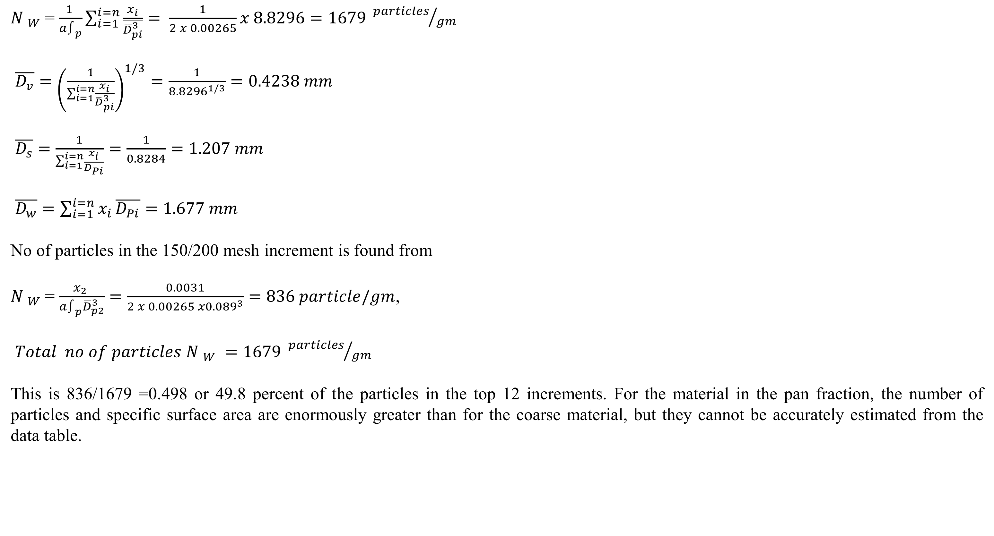
RV College of
Engineering
Go, change the world
${A }_{W}$= $\frac{6 }{φ_{s}∫_{p}}\sum_{i=1}^{i=n}{\frac{x_{i}}{\overline{D_{Pi}}}}=\frac{6}{0.571 x 0.00265}X 0.08284=3309 {{mm}^{2}}/{gm}$
${N }_{W}$= $\frac{1 }{a∫_{p}}\sum_{i=1}^{i=n}{\frac{x_{i}}{\overline{{\overline{D}}_{pi}^{3}}}= \frac{1}{2 x 0.00265}}x 8.8296=1679 {particles}/{gm}$
$\overline{D_{v}}={\left(\frac{1}{\sum_{i=1}^{i=n}{\frac{x_{i}}{{\overline{D}}_{pi}^{3}}}}\right)}^{1/3}=\frac{1}{{8.8296}^{1/3}}=0.4238 mm$
$\overline{D_{s}}=\frac{1}{\sum_{i=1}^{i=n}{\frac{x_{i}}{\overline{D_{Pi}}}}}=\frac{1}{0.8284}=1.207 mm$
$\overline{D_{w}}=\sum_{i=1}^{i=n}{x_{i}}\overline{D_{Pi}}=1.677 mm$
No of particles in the 150/200 mesh increment is found from
${N }_{W}$= $\frac{x_{2} }{a∫_{p}{\overline{D}}_{p2}^{3}}=\frac{0.0031}{2 x 0.00265 x{0.089}^{3}}=836 particle/gm$,
$Total no of particles {N }_{W} =1679 {particles}/{gm}$
This is 836/1679 =0.498 or 49.8 percent of the particles in the top 12 increments. For the material in the pan fraction, the number of particles and specific surface area are enormously greater than for the coarse material, but they cannot be accurately estimated from the data table.

Slide 8
RV College of
Engineering
Go, change the world
Volume surface mean dia by Cummulative Analysis:
$$\overline{D_{s}}=\frac{1}{\int_{0}^{1}{\frac{x_{i}}{\overline{D_{Pi}}}}}=\frac{1}{0.55}=1.8 mm$$

Slide 9
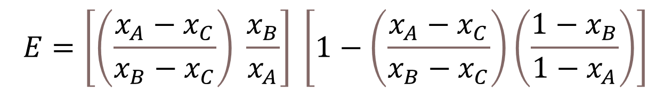
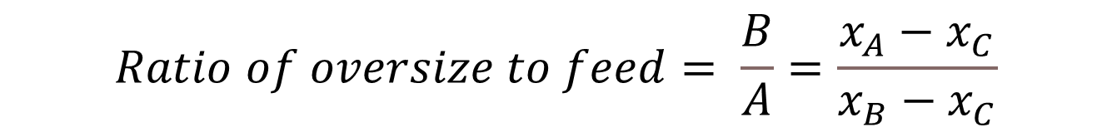
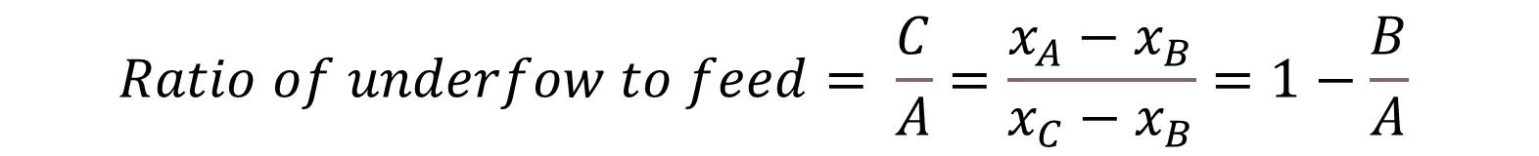
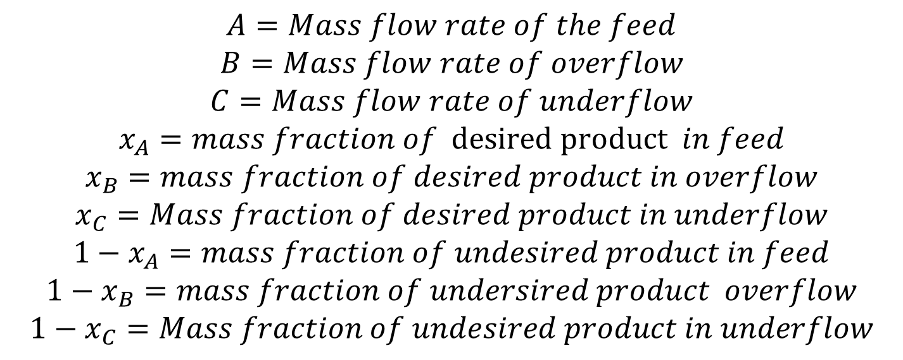
RV College of
Engineering
Go, change the world
EFFECTIVENESS OF SCREENS
$$A=Mass flow rate of the feed$$
$$B=Mass flow rate of overflow$$
$$C=Mass flow rate of underflow$$
$$x_{A}=mass fraction of desired product in feed$$
$$x_{B}=mass fraction of desired product in overflow$$
$$x_{C}=Mass fraction of desired product in underflow$$
$${1−x}_{A}=mass fraction of undesired product in feed$$
$${1−x}_{B}=mass fraction of undersired product overflow$$
$$1−x_{C}=Mass fraction of undesired product in underflow$$
$$E=\left[\left(\frac{x_{A}−x_{C}}{x_{B}−x_{C}}\right) \frac{x_{B}}{x_{A}}\right] \left[1−\left(\frac{x_{A}−x_{C}}{x_{B}−x_{C}}\right)\left(\frac{1−x_{B}}{1−x_{A}}\right)\right]$$
$$Ratio of oversize to feed= \frac{B}{A}=\frac{x_{A}−x_{C}}{x_{B}−x_{C}}$$
$$Ratio of underfow to feed= \frac{C}{A}=\frac{x_{A}−x_{B}}{x_{C}−x_{B}}=1−\frac{B}{A}$$

Slide 10
RV College of
Engineering
Go, change the world
PB. Powdered coal with following screen analysis is fed to a vibrating 48 mesh screen. The particle size distribution is shown in the table.
Determine the effectiveness of the screen taking oversize as product
Determine the effectiveness of the screen taking under size as product
Mesh Size | %Mass Feed | %Retained Oversize | %Retained undersize
-3+4 | 1.07 | 1.8 | 0
-4+6 | 2.35 | 3.3 | 0
-6+8 | 6.72 | 8.8 | 0
-8+10 | 8.64 | 11.2 | 0
-10+14 | 10.87 | 14.2 | 0
-14+20 | 17.59 | 22.9 | 0
-20+28 | 13.97 | 18.2 | 0
-28+35 | 10.77 | 10.4 | 11.95
-35+48 | 10.13 | 6.5 | 21.98
-48+65 | 7.46 | 2.5 | 23.91
-65+100 | 5.1 | 0.2 | 18.77
-100+150 | 3.3 | 0 | 14.27
-150+200 | 0.0212 | 0 | 0.0912

Slide 11
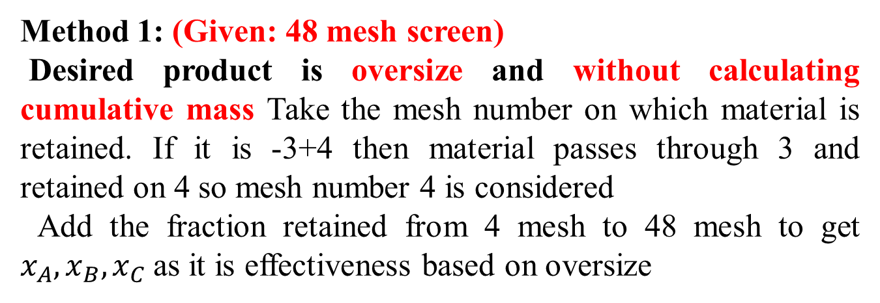
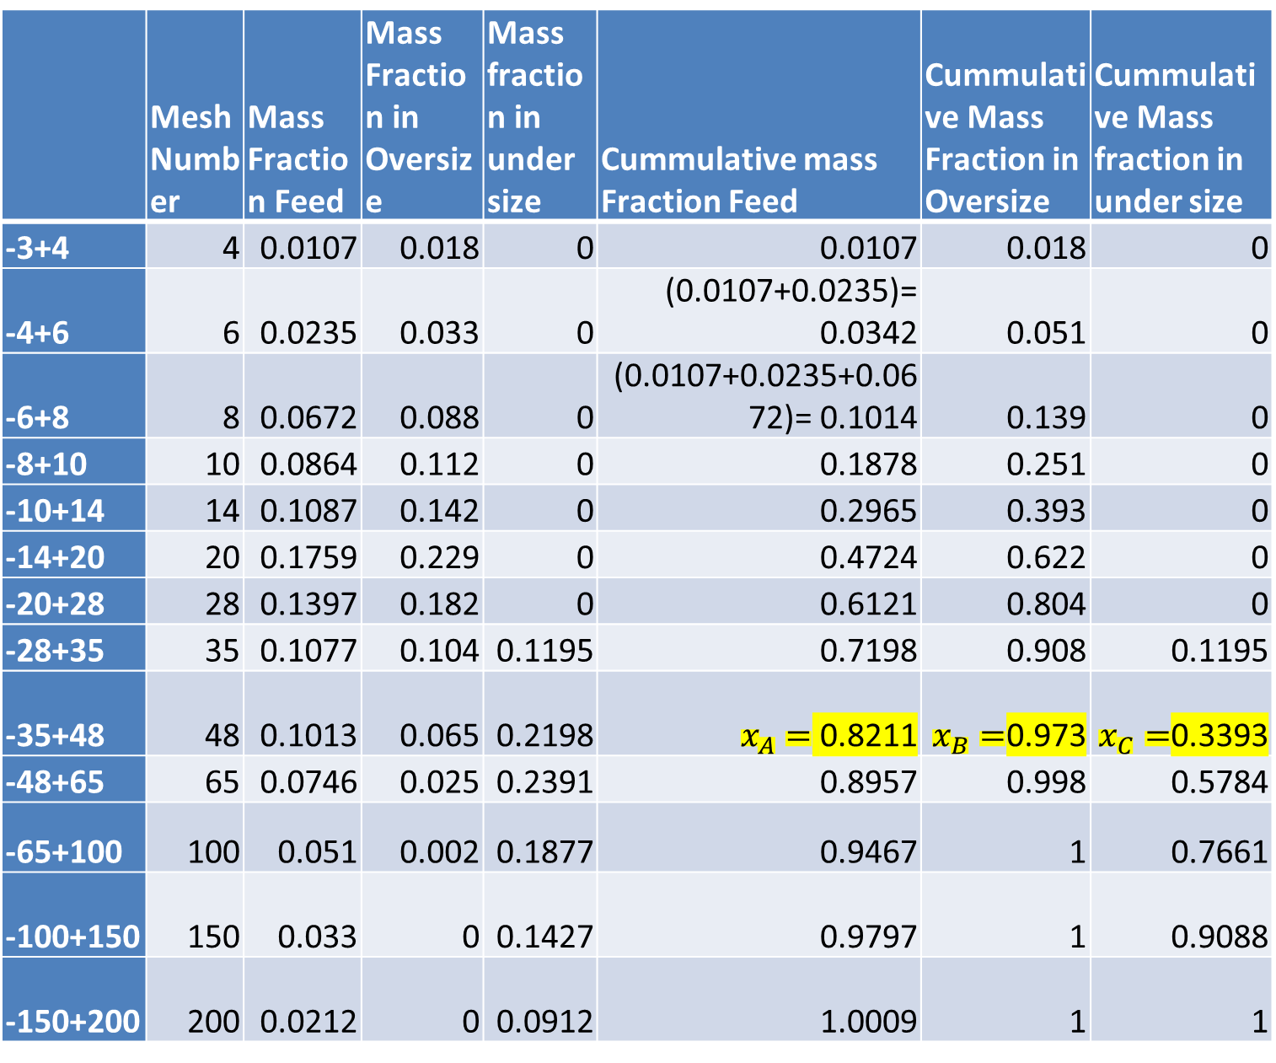
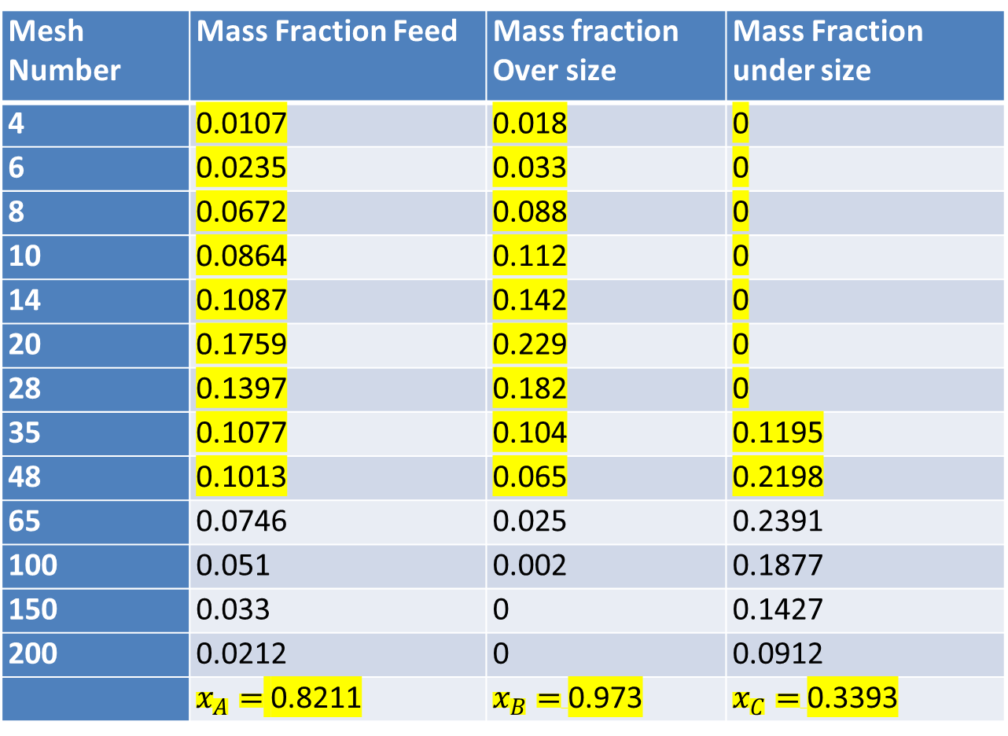
RV College of
Engineering
Go, change the world
Method 2: (Given 48 mesh screen)
Desired product is oversize calculating cumulative mass fraction (Starting from 0 to 1).
Refer to Row with 48 mesh and take the cumulative fractions directly from the row
Method 1: (Given: 48 mesh screen)
Desired product is oversize and without calculating cumulative mass Take the mesh number on which material is retained. If it is -3+4 then material passes through 3 and retained on 4 so mesh number 4 is considered
Add the fraction retained from 4 mesh to 48 mesh to get $x_{A}, x_{B}, x_{C}$as it is effectiveness based on oversize
 | Mesh Number | Mass Fraction Feed | Mass Fraction in Oversize | Mass fraction in under size | Cummulative mass Fraction Feed | Cummulative Mass Fraction in Oversize | Cummulative Mass fraction in under size
-3+4 | 4 | 0.0107 | 0.018 | 0 | 0.0107 | 0.018 | 0
-4+6 | 6 | 0.0235 | 0.033 | 0 | (0.0107+0.0235)= 0.0342 | 0.051 | 0
-6+8 | 8 | 0.0672 | 0.088 | 0 | (0.0107+0.0235+0.0672)= 0.1014 | 0.139 | 0
-8+10 | 10 | 0.0864 | 0.112 | 0 | 0.1878 | 0.251 | 0
-10+14 | 14 | 0.1087 | 0.142 | 0 | 0.2965 | 0.393 | 0
-14+20 | 20 | 0.1759 | 0.229 | 0 | 0.4724 | 0.622 | 0
-20+28 | 28 | 0.1397 | 0.182 | 0 | 0.6121 | 0.804 | 0
-28+35 | 35 | 0.1077 | 0.104 | 0.1195 | 0.7198 | 0.908 | 0.1195
-35+48 | 48 | 0.1013 | 0.065 | 0.2198 | $x_{A}=$ 0.8211 | $x_{B}=$0.973 | $x_{C}=$0.3393
-48+65 | 65 | 0.0746 | 0.025 | 0.2391 | 0.8957 | 0.998 | 0.5784
-65+100 | 100 | 0.051 | 0.002 | 0.1877 | 0.9467 | 1 | 0.7661
-100+150 | 150 | 0.033 | 0 | 0.1427 | 0.9797 | 1 | 0.9088
-150+200 | 200 | 0.0212 | 0 | 0.0912 | 1.0009 | 1 | 1
Mesh Number | Mass Fraction Feed | Mass fraction Over size | Mass Fraction under size
4 | 0.0107 | 0.018 | 0
6 | 0.0235 | 0.033 | 0
8 | 0.0672 | 0.088 | 0
10 | 0.0864 | 0.112 | 0
14 | 0.1087 | 0.142 | 0
20 | 0.1759 | 0.229 | 0
28 | 0.1397 | 0.182 | 0
35 | 0.1077 | 0.104 | 0.1195
48 | 0.1013 | 0.065 | 0.2198
65 | 0.0746 | 0.025 | 0.2391
100 | 0.051 | 0.002 | 0.1877
150 | 0.033 | 0 | 0.1427
200 | 0.0212 | 0 | 0.0912
 | $x_{A}=$ 0.8211 | $x_{B}=$0.973 | $x_{C}=$0.3393
$$E=\left[\left(\frac{x_{A}−x_{C}}{x_{B}−x_{C}}\right) \frac{x_{B}}{x_{A}}\right] \left[1−\left(\frac{x_{A}−x_{C}}{x_{B}−x_{C}}\right)\left(\frac{1−x_{B}}{1−x_{A}}\right)\right]= \left[\frac{0.8211−0.3393}{0.973−0.3393}\right]\frac{0.973}{0.821} \left[1−\left[\frac{0.8211−0.3393}{0.973−0.3393}\right]\frac{(1−0.973)}{(1−0.821)}\right]=0.9 x 0.885=0.7975=79.56\%$$

Slide 12
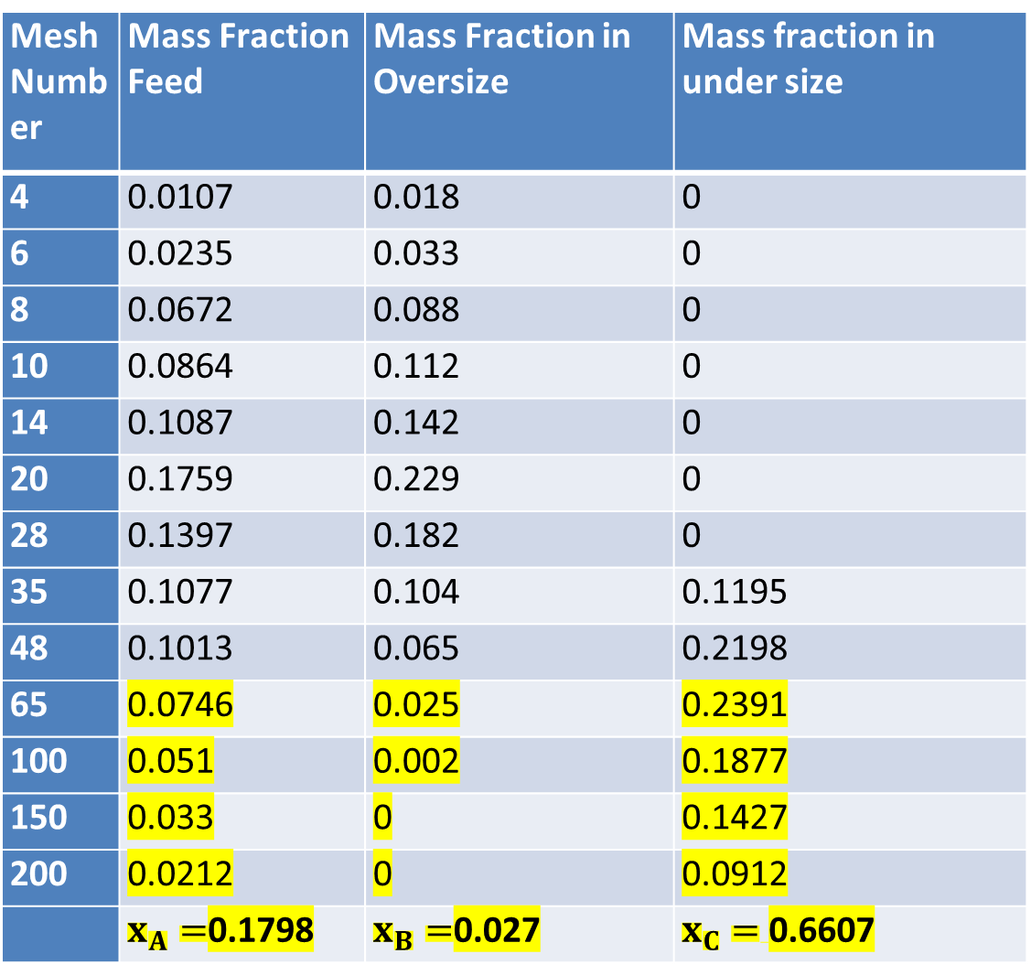
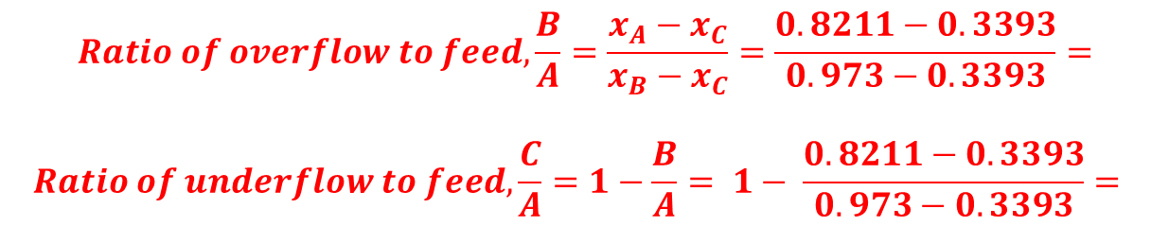
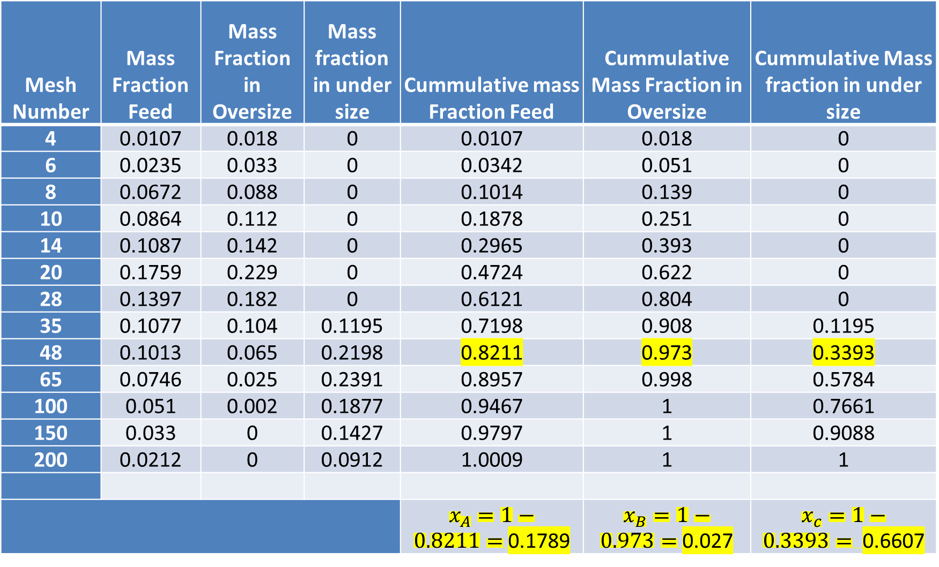
RV College of
Engineering
Go, change the world
Determine the effectiveness of the screen taking under size as desired product. Given: (48 mesh screen).
Method 1: Without calculating cumulative mass fraction.
For undersize we have to consider the material retaind below 48 mesh, and hence add the fractions retained from 65 to 200
Determine the effectiveness of the screen taking under size as product. Given: (48 mesh screen).
Method 1: Considering cumulative fraction from top.
Mesh Number | Mass Fraction Feed | Mass Fraction in Oversize | Mass fraction in under size | Cummulative mass Fraction Feed | Cummulative Mass Fraction in Oversize | Cummulative Mass fraction in under size
4 | 0.0107 | 0.018 | 0 | 0.0107 | 0.018 | 0
6 | 0.0235 | 0.033 | 0 | 0.0342 | 0.051 | 0
8 | 0.0672 | 0.088 | 0 | 0.1014 | 0.139 | 0
10 | 0.0864 | 0.112 | 0 | 0.1878 | 0.251 | 0
14 | 0.1087 | 0.142 | 0 | 0.2965 | 0.393 | 0
20 | 0.1759 | 0.229 | 0 | 0.4724 | 0.622 | 0
28 | 0.1397 | 0.182 | 0 | 0.6121 | 0.804 | 0
35 | 0.1077 | 0.104 | 0.1195 | 0.7198 | 0.908 | 0.1195
48 | 0.1013 | 0.065 | 0.2198 | 0.8211 | 0.973 | 0.3393
65 | 0.0746 | 0.025 | 0.2391 | 0.8957 | 0.998 | 0.5784
100 | 0.051 | 0.002 | 0.1877 | 0.9467 | 1 | 0.7661
150 | 0.033 | 0 | 0.1427 | 0.9797 | 1 | 0.9088
200 | 0.0212 | 0 | 0.0912 | 1.0009 | 1 | 1
 |  |  |  | $x_{A}=1−0.8211=$0.1789 | $x_{B}=1−0.973=$0.027 | $x_{c}=1−0.3393=$0.6607
Mesh Number | Mass Fraction Feed | Mass Fraction in Oversize | Mass fraction in under size
4 | 0.0107 | 0.018 | 0
6 | 0.0235 | 0.033 | 0
8 | 0.0672 | 0.088 | 0
10 | 0.0864 | 0.112 | 0
14 | 0.1087 | 0.142 | 0
20 | 0.1759 | 0.229 | 0
28 | 0.1397 | 0.182 | 0
35 | 0.1077 | 0.104 | 0.1195
48 | 0.1013 | 0.065 | 0.2198
65 | 0.0746 | 0.025 | 0.2391
100 | 0.051 | 0.002 | 0.1877
150 | 0.033 | 0 | 0.1427
200 | 0.0212 | 0 | 0.0912
 | $x_{A}=$0.1798 | $x_{B}=$0.027 | $x_{C}=$0.6607
$x_{A}=1−0.8211=$0.1789, $x_{B}=1−0.973=$0.027 $x_{c}=1−0.3393=$0.6607
$$Ratio of overflow to feed, \frac{B}{A}=\frac{x_{A}−x_{C}}{x_{B}−x_{C}}=\frac{0.8211−0.3393}{0.973−0.3393}=$$
$$Ratio of underflow to feed, \frac{C}{A}=1−\frac{B}{A}= 1− \frac{0.8211−0.3393}{0.973−0.3393}=$$
$$E=\left[\left(\frac{x_{A}−x_{C}}{x_{B}−x_{C}}\right) \frac{x_{B}}{x_{A}}\right] \left[1−\left(\frac{x_{A}−x_{C}}{x_{B}−x_{C}}\right)\left(\frac{1−x_{B}}{1−x_{A}}\right)\right]=0.8853 x 0.9=79.76\%$$

Slide 13
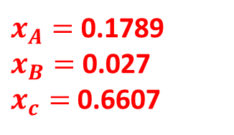
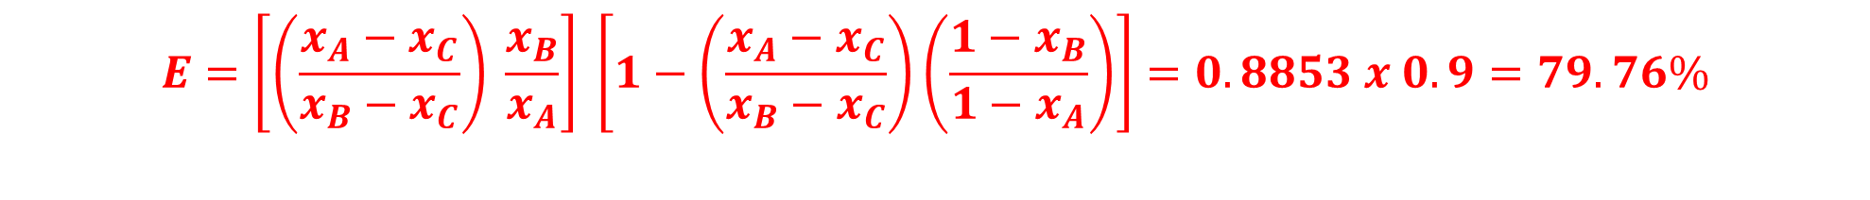
RV College of
Engineering
Go, change the world
Type 3: Considering cumulative fraction from bottom (Given 48 Mesh)
Note: Negative mesh numbers are to be considered if cumulative fraction is considered from bottom (Start with 1 to 0)
 | Mesh Number | Mass Fraction Feed | Mass Fraction in Oversize | Mass fraction in under size | Cummulative mass Fraction Feed | Cummulative Mass Fraction in Oversize | Cummulative Mass fraction in under size
 | 3 |  |  |  | 1 | 1 | 1
-3+4 | 4 | 0.0107 | 0.018 | 0 | 0.9893 | 0.982 | 1
-4+6 | 6 | 0.0235 | 0.033 | 0 | 0.9658 | 0.949 | 1
-6+8 | 8 | 0.0672 | 0.088 | 0 | 0.8986 | 0.861 | 1
-8+10 | 10 | 0.0864 | 0.112 | 0 | 0.8122 | 0.749 | 1
-10+14 | 14 | 0.1087 | 0.142 | 0 | 0.7035 | 0.607 | 1
-14+20 | 20 | 0.1759 | 0.229 | 0 | 0.5276 | 0.378 | 1
-20+28 | 28 | 0.1397 | 0.182 | 0 | 0.3879 | 0.196 | 1
-28+35 | 35 | 0.1077 | 0.104 | 0.1195 | 0.2802 | 0.092 | 0.8805
-35+48 | 48 | 0.1013 | 0.065 | 0.2198 | 0.1789 | 0.027 | 0.6607
-48+65 | 65 | 0.0746 | 0.025 | 0.2391 | 0.1043 | 0.002 | 0.4216
-65+100 | 100 | 0.051 | 0.002 | 0.1877 | 0.0533 | 0 | 0.2339
-100+150 | 150 | 0.033 | 0 | 0.1427 | 0.0203 | 0 | 0.0912
-150+200
$x_{A}=$0.1789
$x_{B}=$0.027
$x_{c}=$0.6607
$$E=\left[\left(\frac{x_{A}−x_{C}}{x_{B}−x_{C}}\right) \frac{x_{B}}{x_{A}}\right] \left[1−\left(\frac{x_{A}−x_{C}}{x_{B}−x_{C}}\right)\left(\frac{1−x_{B}}{1−x_{A}}\right)\right]=0.8853 x 0.9=79.76\%$$

Slide 14
RV College of
Engineering
Go, change the world
Pb. Following is the Particle Size Distribution (PSD) of three cuts obtained from a double deck vibrating screen (48 and 65 mesh). The mass ratio of oversize:Internediate:Undersize is 3:3:4.
Construct particle size distribution for 48 and 65 mesh.
Calculate effectiveness of 48 and 65 mesh screens individually if oversize is desired product and if under size is desired product.
Calculate the effectiveness of double deck vibrating screen system as a whole taking intermediate as product.
 | Mass Fraction Retained
Mesh No | Oversize | Intermediate | Undersize
14 | 0.0012 | 0 | 0
20 | 0.0068 | 0 | 0
28 | 0.189 | 0.2 | 0
35 | 0.389 | 0.039 | 0.001
48 | 0.337 | 0.322 | 0.003
65 | 0.066 | 0.526 | 0.344
100 | 0.005 | 0.067 | 0.299
150 | 0.005 | 0.024 | 0.237
200 | 0.001 | 0.002 | 0.116

Slide 15
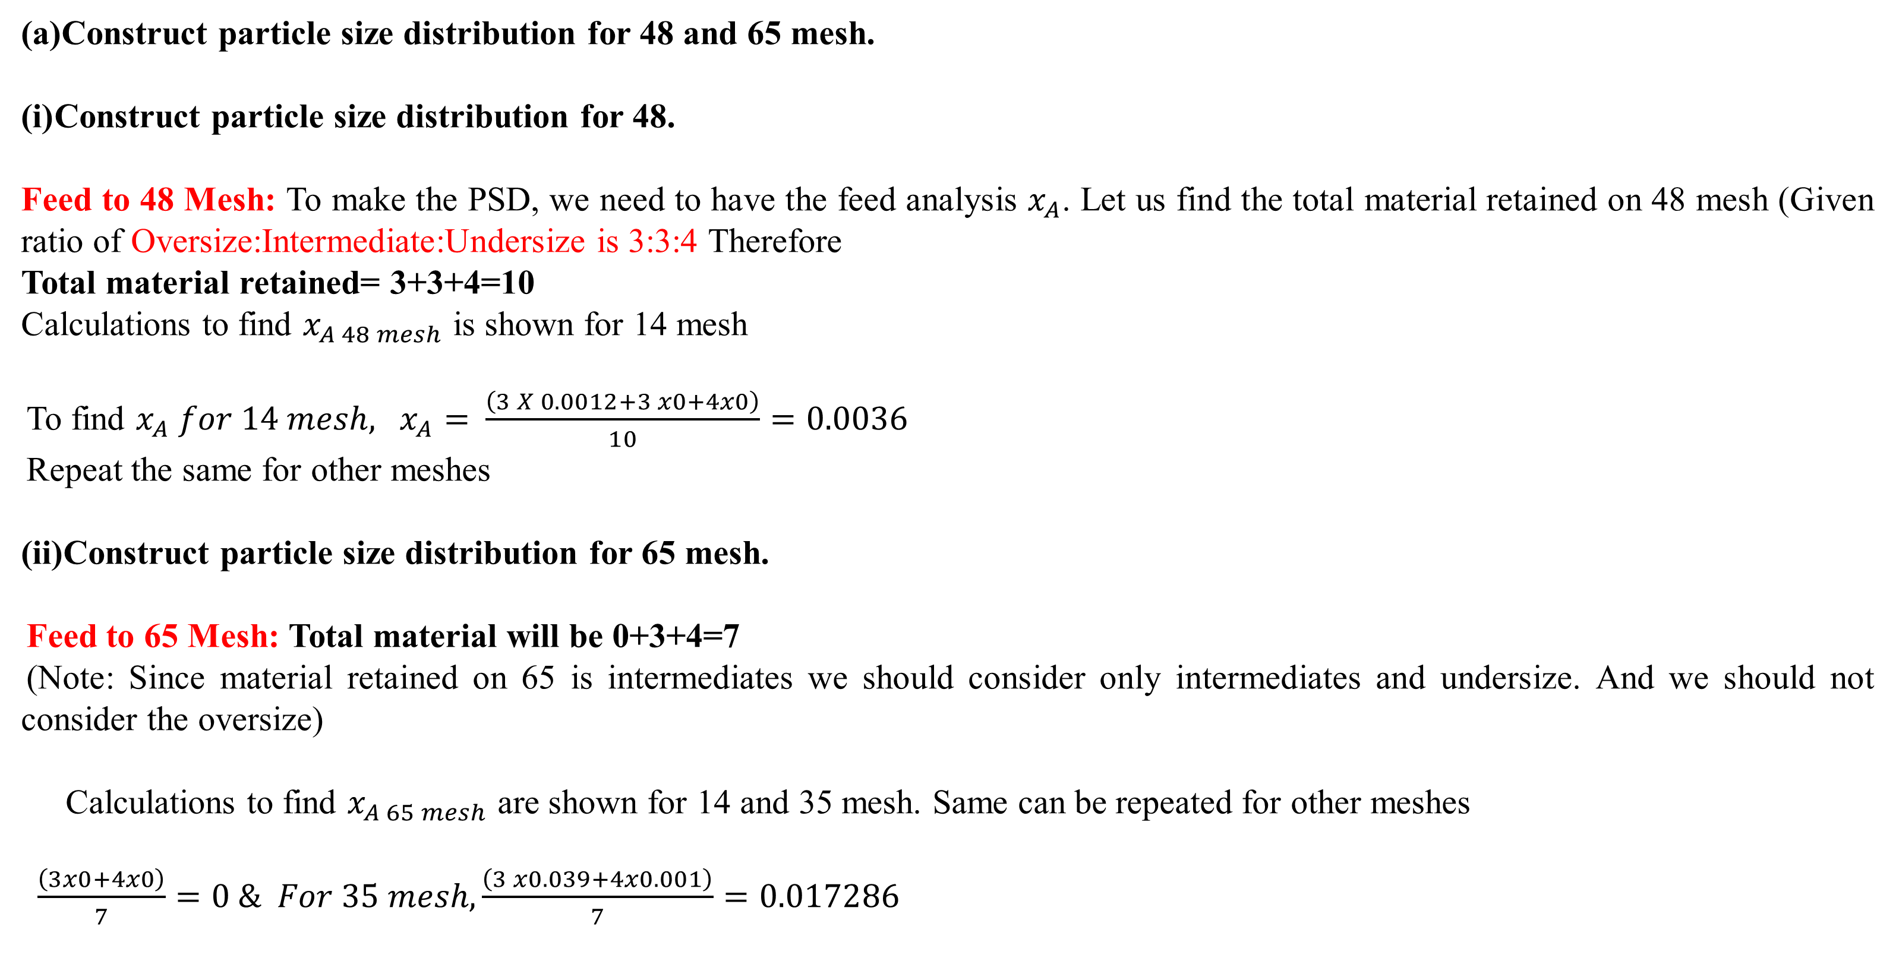
RV College of
Engineering
Go, change the world
Construct particle size distribution for 48 and 65 mesh.
Construct particle size distribution for 48.
Feed to 48 Mesh: To make the PSD, we need to have the feed analysis $x_{A}$. Let us find the total material retained on 48 mesh (Given ratio of Oversize:Intermediate:Undersize is 3:3:4 Therefore
Total material retained= 3+3+4=10
Calculations to find $x_{A 48 mesh}$ is shown for 14 mesh
To find $x_{A} for 14 mesh,$ $x_{A}=$ $\frac{\left(3 X 0.0012+3 x0+4x0\right)}{10}=0.0036$
Repeat the same for other meshes
Construct particle size distribution for 65 mesh.
Feed to 65 Mesh: Total material will be 0+3+4=7
(Note: Since material retained on 65 is intermediates we should consider only intermediates and undersize. And we should not consider the oversize)
Calculations to find $x_{A 65 mesh}$ are shown for 14 and 35 mesh. Same can be repeated for other meshes
$\frac{\left(3x0+4x0\right)}{7}=0 \& For 35 mesh, \frac{\left(3 x0.039+4x0.001\right)}{7}=0.017286$

Slide 16
RV College of
Engineering
Go, change the world
 | Mass Fraction Retained
Mesh No | Oversize | Intermediate | Undersize | Feed to 48 Mesh | Feed to 65 Mesh
14 | 0.0012 | 0 | 0 | 0.00036 | 0
20 | 0.0068 | 0 | 0 | 0.00204 | 0
28 | 0.189 | 0.2 | 0 | 0.1167 | 0.085714
35 | 0.389 | 0.039 | 0.001 | 0.1288 | 0.017286
48 | 0.337 | 0.322 | 0.003 | 0.1989 | 0.139714
65 | 0.066 | 0.526 | 0.344 | 0.3152 | 0.422
100 | 0.005 | 0.067 | 0.299 | 0.1412 | 0.199571
150 | 0.005 | 0.024 | 0.237 | 0.1035 | 0.145714
200 | 0.001 | 0.002 | 0.116 | 0.0473 | 0.067143

Slide 17
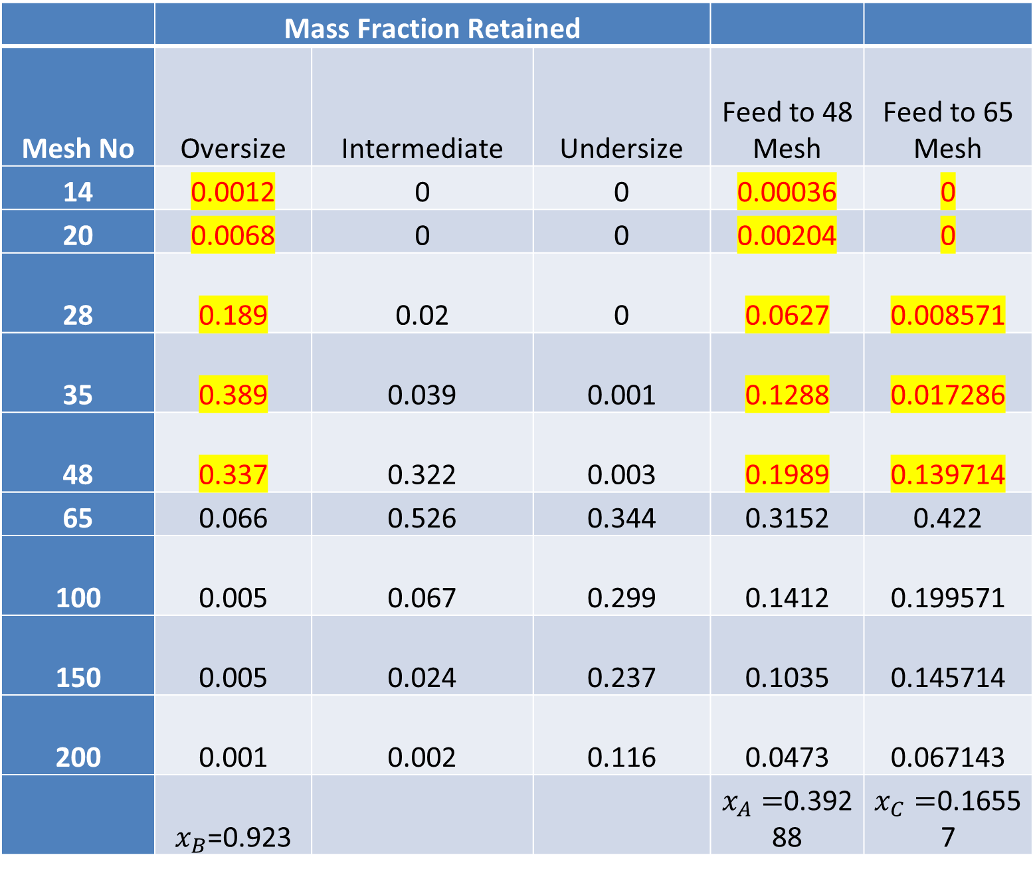
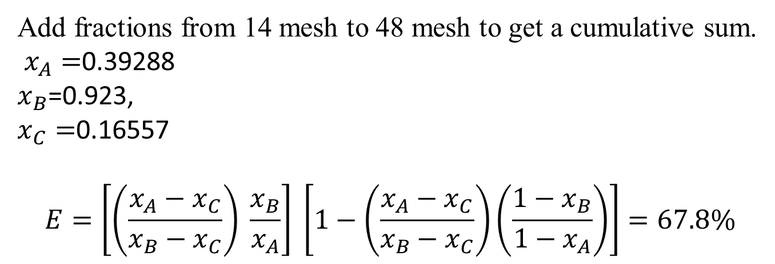
RV College of
Engineering
Go, change the world
(B)Calculate effectiveness of 48 and 65 mesh screens individually
Effectiveness of 48 mesh if oversize is desired product
 | Mass Fraction Retained
Mesh No | Oversize | Intermediate | Undersize | Feed to 48 Mesh | Feed to 65 Mesh
14 | 0.0012 | 0 | 0 | 0.00036 | 0
20 | 0.0068 | 0 | 0 | 0.00204 | 0
28 | 0.189 | 0.02 | 0 | 0.0627 | 0.008571
35 | 0.389 | 0.039 | 0.001 | 0.1288 | 0.017286
48 | 0.337 | 0.322 | 0.003 | 0.1989 | 0.139714
65 | 0.066 | 0.526 | 0.344 | 0.3152 | 0.422
100 | 0.005 | 0.067 | 0.299 | 0.1412 | 0.199571
150 | 0.005 | 0.024 | 0.237 | 0.1035 | 0.145714
200 | 0.001 | 0.002 | 0.116 | 0.0473 | 0.067143
 | $x_{B}$=0.923 |  |  | $x_{A}=$0.39288 | $x_{C}=$0.16557
Add fractions from 14 mesh to 48 mesh to get a cumulative sum.
$x_{A}=$0.39288
$x_{B}$=0.923,
$x_{C}=$0.16557
$$E=\left[\left(\frac{x_{A}−x_{C}}{x_{B}−x_{C}}\right) \frac{x_{B}}{x_{A}}\right] \left[1−\left(\frac{x_{A}−x_{C}}{x_{B}−x_{C}}\right)\left(\frac{1−x_{B}}{1−x_{A}}\right)\right]=67.8\%$$

Slide 18
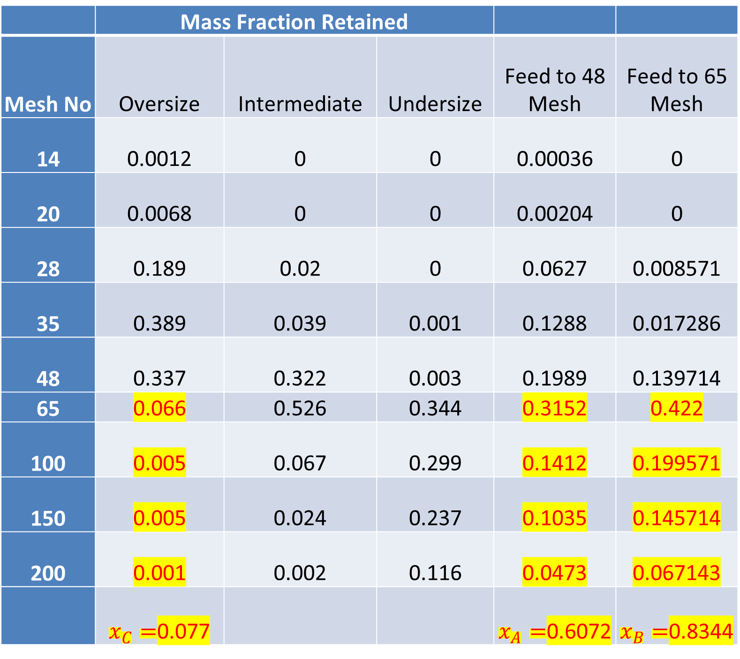
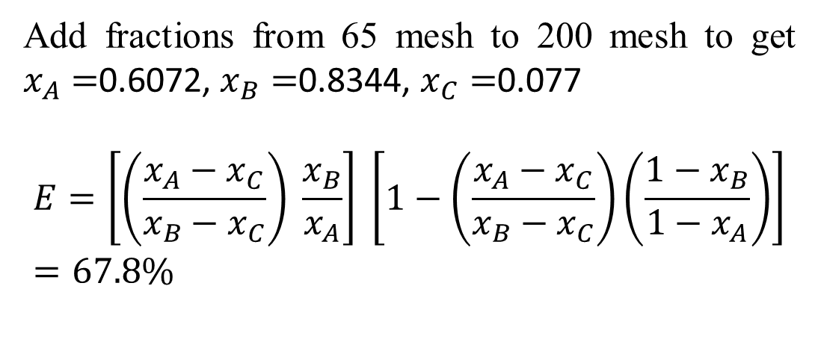
RV College of
Engineering
Go, change the world
Effectiveness of 48 mesh if undersize is desired product
 | Mass Fraction Retained
Mesh No | Oversize | Intermediate | Undersize | Feed to 48 Mesh | Feed to 65 Mesh
14 | 0.0012 | 0 | 0 | 0.00036 | 0
20 | 0.0068 | 0 | 0 | 0.00204 | 0
28 | 0.189 | 0.02 | 0 | 0.0627 | 0.008571
35 | 0.389 | 0.039 | 0.001 | 0.1288 | 0.017286
48 | 0.337 | 0.322 | 0.003 | 0.1989 | 0.139714
65 | 0.066 | 0.526 | 0.344 | 0.3152 | 0.422
100 | 0.005 | 0.067 | 0.299 | 0.1412 | 0.199571
150 | 0.005 | 0.024 | 0.237 | 0.1035 | 0.145714
200 | 0.001 | 0.002 | 0.116 | 0.0473 | 0.067143
 | $x_{C}=$0.077 |  |  | $x_{A}=$0.6072 | $x_{B}=$0.8344
Add fractions from 65 mesh to 200 mesh to get $x_{A}=$0.6072, $x_{B}=$0.8344, $x_{C}=$0.077
$$E=\left[\left(\frac{x_{A}−x_{C}}{x_{B}−x_{C}}\right) \frac{x_{B}}{x_{A}}\right] \left[1−\left(\frac{x_{A}−x_{C}}{x_{B}−x_{C}}\right)\left(\frac{1−x_{B}}{1−x_{A}}\right)\right]=67.8\%$$

Slide 19
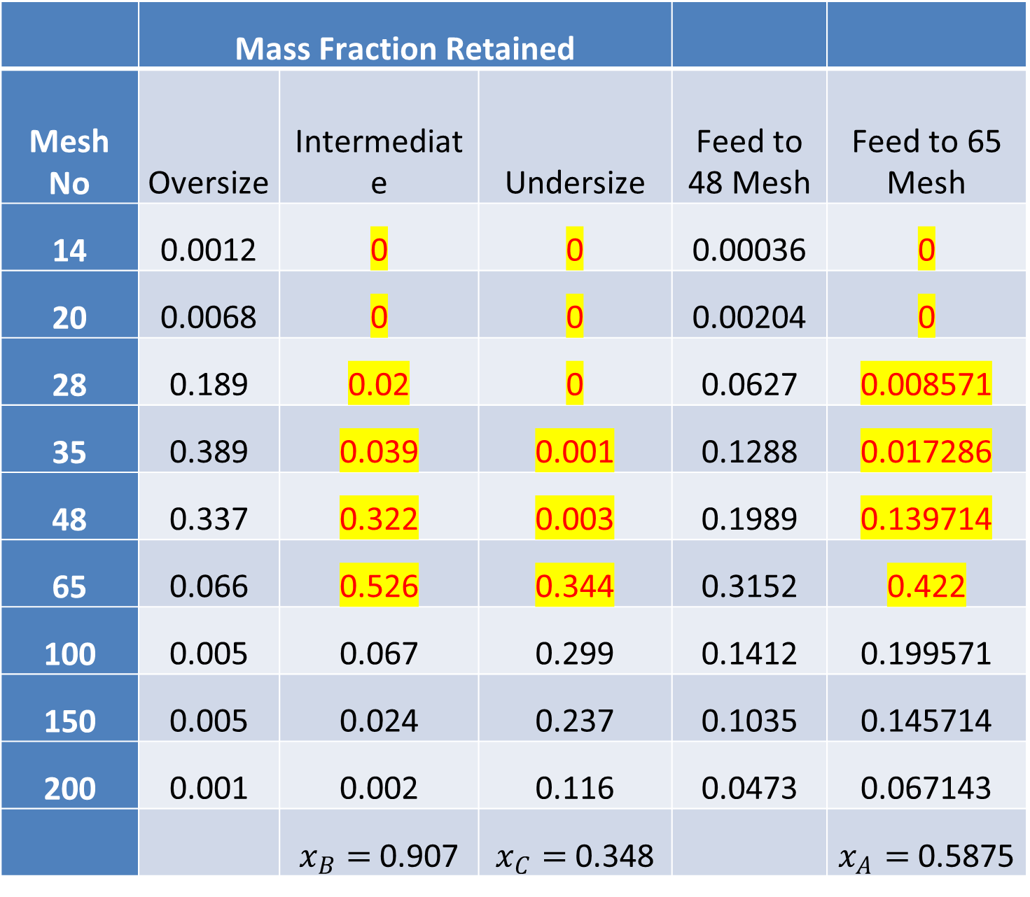
RV College of
Engineering
Go, change the world
Effectiveness of 65 mesh if Over size is desired product
 | Mass Fraction Retained
Mesh No | Oversize | Intermediate | Undersize | Feed to 48 Mesh | Feed to 65 Mesh
14 | 0.0012 | 0 | 0 | 0.00036 | 0
20 | 0.0068 | 0 | 0 | 0.00204 | 0
28 | 0.189 | 0.02 | 0 | 0.0627 | 0.008571
35 | 0.389 | 0.039 | 0.001 | 0.1288 | 0.017286
48 | 0.337 | 0.322 | 0.003 | 0.1989 | 0.139714
65 | 0.066 | 0.526 | 0.344 | 0.3152 | 0.422
100 | 0.005 | 0.067 | 0.299 | 0.1412 | 0.199571
150 | 0.005 | 0.024 | 0.237 | 0.1035 | 0.145714
200 | 0.001 | 0.002 | 0.116 | 0.0473 | 0.067143
 |  | $x_{B}=$0.907 | $x_{C}=$0.348 |  | $x_{A}=$0.5875
$E=\left[\left(\frac{x_{A}−x_{C}}{x_{B}−x_{C}}\right) \frac{x_{B}}{x_{A}}\right] \left[1−\left(\frac{x_{A}−x_{C}}{x_{B}−x_{C}}\right)\left(\frac{1−x_{B}}{1−x_{A}}\right)\right]=$ 59.76%

Slide 20
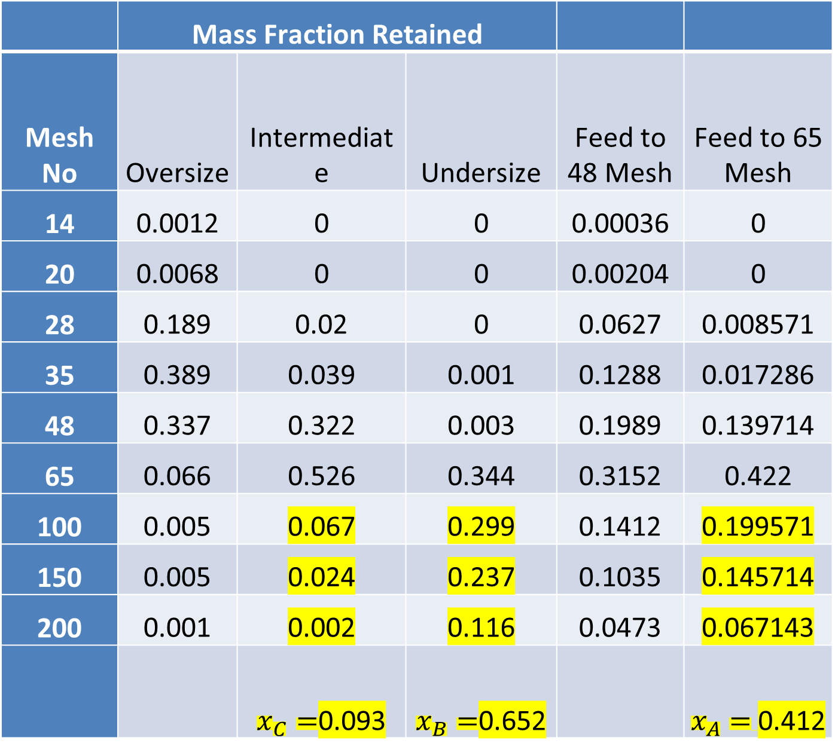
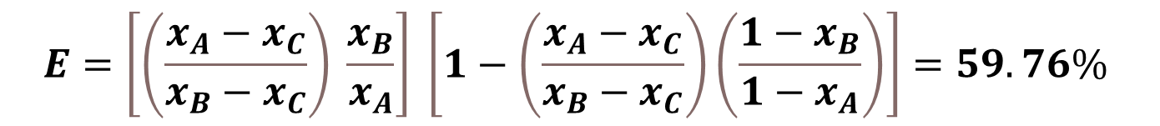
RV College of
Engineering
Go, change the world
Effectiveness of 65 mesh if under size is desired product
 | Mass Fraction Retained
Mesh No | Oversize | Intermediate | Undersize | Feed to 48 Mesh | Feed to 65 Mesh
14 | 0.0012 | 0 | 0 | 0.00036 | 0
20 | 0.0068 | 0 | 0 | 0.00204 | 0
28 | 0.189 | 0.02 | 0 | 0.0627 | 0.008571
35 | 0.389 | 0.039 | 0.001 | 0.1288 | 0.017286
48 | 0.337 | 0.322 | 0.003 | 0.1989 | 0.139714
65 | 0.066 | 0.526 | 0.344 | 0.3152 | 0.422
100 | 0.005 | 0.067 | 0.299 | 0.1412 | 0.199571
150 | 0.005 | 0.024 | 0.237 | 0.1035 | 0.145714
200 | 0.001 | 0.002 | 0.116 | 0.0473 | 0.067143
 |  | $x_{C}=$0.093 | $x_{B}=$0.652 |  | $x_{A}=$0.412
$$E=\left[\left(\frac{x_{A}−x_{C}}{x_{B}−x_{C}}\right) \frac{x_{B}}{x_{A}}\right] \left[1−\left(\frac{x_{A}−x_{C}}{x_{B}−x_{C}}\right)\left(\frac{1−x_{B}}{1−x_{A}}\right)\right]=59.76\%$$

Slide 21
RV College of
Engineering
Go, change the world
Pb1. It is desired to separate a mixture of solids into three fractions a coarse fraction retained on 8 mesh, a middle fraction passing through 8 mesh and retained on 10 mesh and a fine fraction passing through 10 mesh. Based on the screen analysis given below, determine the weight ration of each of the three fractions with feed, the overall effectiveness of 8 mesh and 10 mesh screens
Screen | Feed | Coarse fraction | Middle fraction | Fine fraction
3/4 | 3.5 | 14 | 0 | 0
4/6 | 15 | 50 | 4.2 | 0
6/8 | 27.5 | 24 | 35.8 | o
8/10 | 23.5 | 8 | 30.8 | 20
10/14 | 16 | 4 | 18.3 | 26.7
14/20 | 9.1 | 0 | 10.2 | 20.2
20/28 | 3.4 | 0 | 0.7 | 19.6
28/35 | 1.3 | 0 | 0 | 8.9
35/48 | 0.7 | 0 | 0 | 4.6

Slide 22
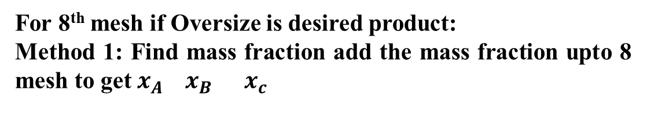
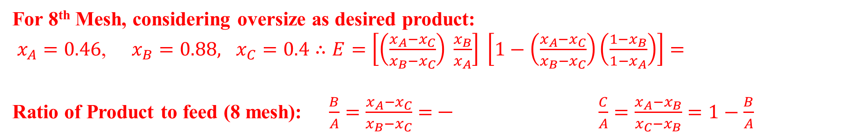
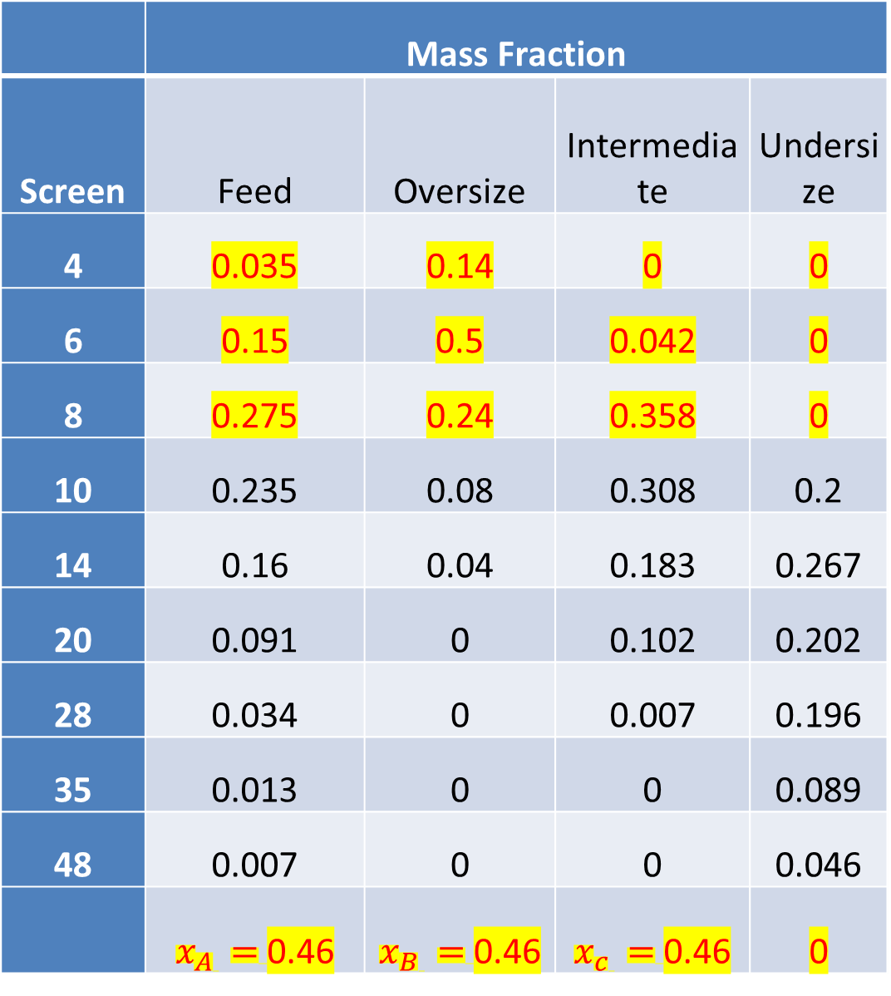
RV College of
Engineering
Go, change the world
For 8th mesh if Oversize is desired product:
Method 1: Find mass fraction add the mass fraction upto 8 mesh to get $x_{A}{ x}_{B}{ x}_{c}$
Method 2: Take cumulative mass fraction to get $x_{A}{ x}_{B}{ x}_{c}$
 | Mass Fraction
Screen | Feed | Oversize | Intermediate | Undersize
4 | 0.035 | 0.14 | 0 | 0
6 | 0.15 | 0.5 | 0.042 | 0
8 | 0.275 | 0.24 | 0.358 | 0
10 | 0.235 | 0.08 | 0.308 | 0.2
14 | 0.16 | 0.04 | 0.183 | 0.267
20 | 0.091 | 0 | 0.102 | 0.202
28 | 0.034 | 0 | 0.007 | 0.196
35 | 0.013 | 0 | 0 | 0.089
48 | 0.007 | 0 | 0 | 0.046
 | $x_{A }=$0.46 | $x_{B }=$0.46 | $x_{c }=$0.46 | 0
 | Mass Fraction |  |  |  | Cummulative mass fraction
 | Feed | Oversize | Intermediate | Undersize | Feed | Oversize | Intermediate | Undersize
4 | 0.035 | 0.14 | 0 | 0 | 0.035 | 0.14 | 0 | 0
6 | 0.15 | 0.5 | 0.042 | 0 | 0.185 | 0.64 | 0.042 | 0
8 | 0.275 | 0.24 | 0.358 | 0 | 0.46 | 0.88 | 0.4 | 0
10 | 0.235 | 0.08 | 0.308 | 0.2 | 0.695 | 0.96 | 0.708 | 0.2
14 | 0.16 | 0.04 | 0.183 | 0.267 | 0.855 | 1 | 0.891 | 0.467
20 | 0.091 | 0 | 0.102 | 0.202 | 0.946 | 1 | 0.993 | 0.669
28 | 0.034 | 0 | 0.007 | 0.196 | 0.98 | 1 | 1 | 0.865
35 | 0.013 | 0 | 0 | 0.089 | 0.993 | 1 | 1 | 0.954
48 | 0.007 | 0 | 0 | 0.046 | 1 | 1 | 1 | 1
For 8th Mesh, considering oversize as desired product:
$x_{A}=0.46$, $x_{B}=0.88,$ $x_{C}=0.4$ $∴E=\left[\left(\frac{x_{A}−x_{C}}{x_{B}−x_{C}}\right) \frac{x_{B}}{x_{A}}\right] \left[1−\left(\frac{x_{A}−x_{C}}{x_{B}−x_{C}}\right)\left(\frac{1−x_{B}}{1−x_{A}}\right)\right]=$
Ratio of Product to feed (8 mesh): $\frac{B}{A}=\frac{x_{A}−x_{C}}{x_{B}−x_{C}}=\frac{}{} \frac{C}{A}=\frac{x_{A}−x_{B}}{x_{C}−x_{B}}=1−\frac{B}{A}$

Slide 23
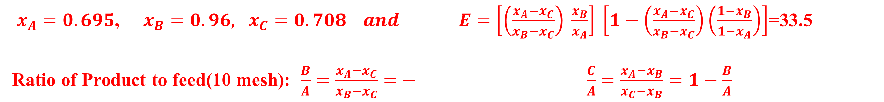
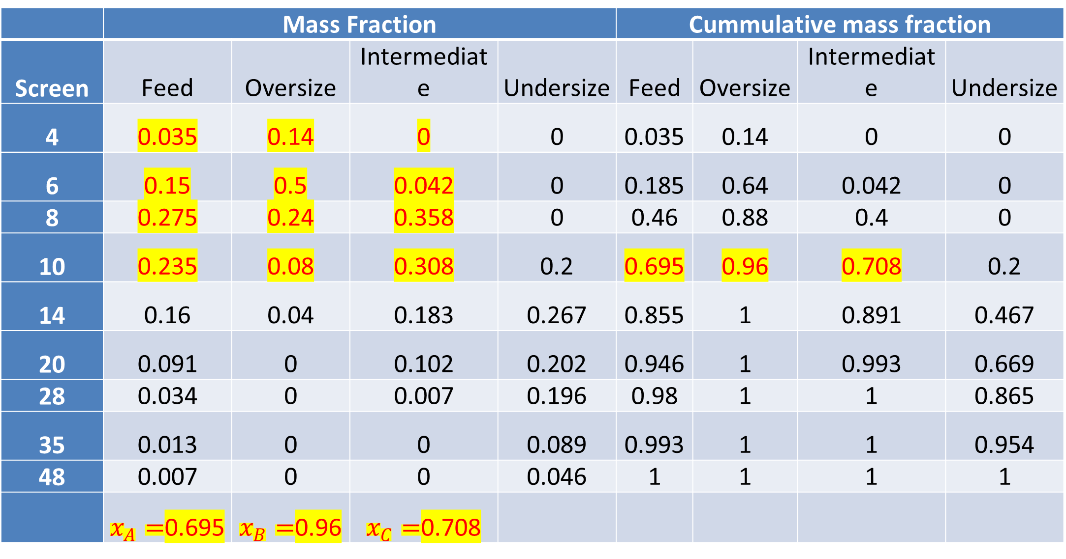
RV College of
Engineering
Go, change the world
For 10 mesh, If undersize is the desired product Method 1 Add fractions from 4 mesh to 10 mesh to get $x_{A}{ x}_{B}{ x}_{c}$ . Or take Cummulative fractions
 | Mass Fraction |  |  |  | Cummulative mass fraction
Screen | Feed | Oversize | Intermediate | Undersize | Feed | Oversize | Intermediate | Undersize
4 | 0.035 | 0.14 | 0 | 0 | 0.035 | 0.14 | 0 | 0
6 | 0.15 | 0.5 | 0.042 | 0 | 0.185 | 0.64 | 0.042 | 0
8 | 0.275 | 0.24 | 0.358 | 0 | 0.46 | 0.88 | 0.4 | 0
10 | 0.235 | 0.08 | 0.308 | 0.2 | 0.695 | 0.96 | 0.708 | 0.2
14 | 0.16 | 0.04 | 0.183 | 0.267 | 0.855 | 1 | 0.891 | 0.467
20 | 0.091 | 0 | 0.102 | 0.202 | 0.946 | 1 | 0.993 | 0.669
28 | 0.034 | 0 | 0.007 | 0.196 | 0.98 | 1 | 1 | 0.865
35 | 0.013 | 0 | 0 | 0.089 | 0.993 | 1 | 1 | 0.954
48 | 0.007 | 0 | 0 | 0.046 | 1 | 1 | 1 | 1
 | $x_{A}=$0.695 | $x_{B}=$0.96 | $x_{C}=$0.708
$x_{A}=0.695$, $x_{B}=0.96,$ $x_{C}=0.708 and$ $E=\left[\left(\frac{x_{A}−x_{C}}{x_{B}−x_{C}}\right) \frac{x_{B}}{x_{A}}\right] \left[1−\left(\frac{x_{A}−x_{C}}{x_{B}−x_{C}}\right)\left(\frac{1−x_{B}}{1−x_{A}}\right)\right]$=33.5
Ratio of Product to feed(10 mesh): $\frac{B}{A}=\frac{x_{A}−x_{C}}{x_{B}−x_{C}}=\frac{}{}$ $\frac{C}{A}=\frac{x_{A}−x_{B}}{x_{C}−x_{B}}=1−\frac{B}{A}$

Slide 24
RV College of
Engineering
Go, change the world
Lab Pblm: The following data was obtained from a screen analysis of quartz sample. Find the effectiveness of the screen having average aperture dia 1.6 mm
Mesh number | Mesh Number | Aperture Dia (mm) | Mass Fraction Feed | Mass Fraction in Oversize | Mass fraction in under size
 | 3 | 6.73
-3+4 | 4 | 4.699 | 0.0107 | 0.018 | 0
-4+6 | 6 | 3.327 | 0.0235 | 0.033 | 0
-6+8 | 8 | 2.362 | 0.0672 | 0.088 | 0
-8+10 | 10 | 1.651 | 0.0864 | 0.112 | 0
-10+14 | 14 | 1.168 | 0.1087 | 0.142 | 0
-14+20 | 20 | 0.833 | 0.1759 | 0.229 | 0
-20+28 | 28 | 0.589 | 0.1397 | 0.182 | 0
-28+35 | 35 | 0.417 | 0.1077 | 0.104 | 0.1195
-35+48 | 48 | 0.295 | 0.1013 | 0.065 | 0.2198
-48+65 | 65 | 0.296 | 0.0746 | 0.025 | 0.2391
-65+100 | 100 | 0.297 | 0.051 | 0.002 | 0.1877
-100+150 | 150 | 0.298 | 0.033 | 0 | 0.1427
-150+200 | 200 | 0.299

Slide 25
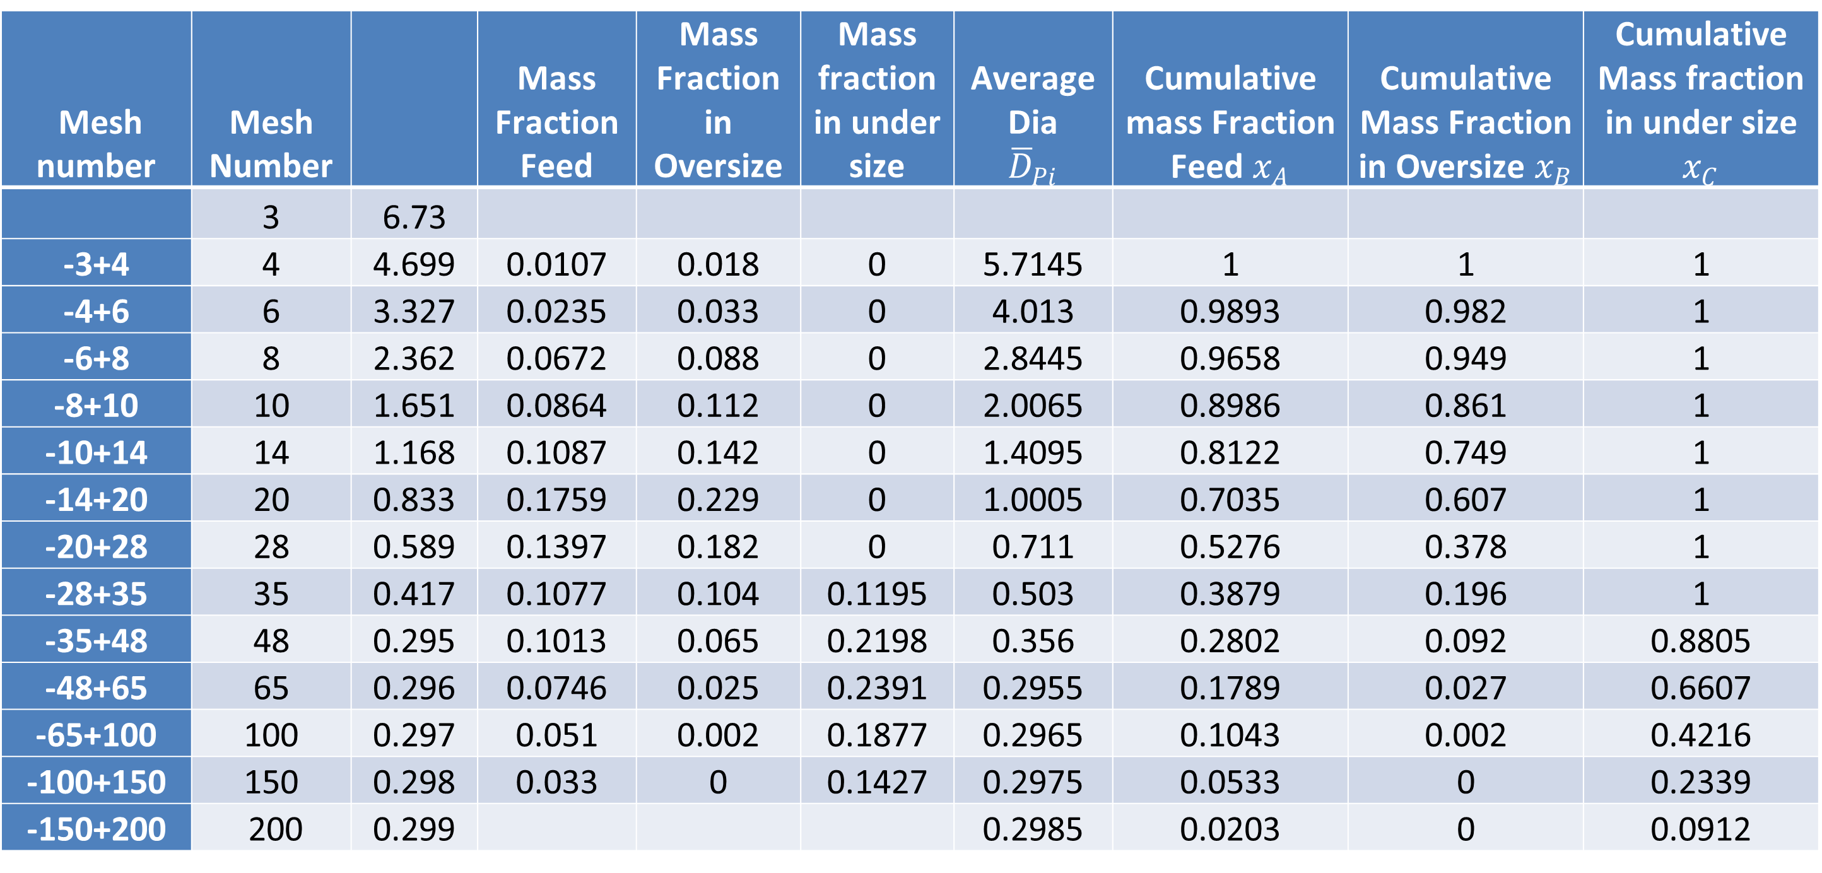
RV College of
Engineering
Go, change the world
Solution: Calculate average aperture dia and cumulative fractions of feed, oversize and under size. Plot the graph of cumulative mass fraction vs average particle size.
Mesh number | Mesh Number |  | Mass Fraction Feed | Mass Fraction in Oversize | Mass fraction in under size | Average Dia $${\overline{D}}_{Pi}$$ | Cumulative mass Fraction Feed $x_{A}$ | Cumulative Mass Fraction in Oversize $x_{B}$ | Cumulative Mass fraction in under size $x_{C}$
 | 3 | 6.73
-3+4 | 4 | 4.699 | 0.0107 | 0.018 | 0 | 5.7145 | 1 | 1 | 1
-4+6 | 6 | 3.327 | 0.0235 | 0.033 | 0 | 4.013 | 0.9893 | 0.982 | 1
-6+8 | 8 | 2.362 | 0.0672 | 0.088 | 0 | 2.8445 | 0.9658 | 0.949 | 1
-8+10 | 10 | 1.651 | 0.0864 | 0.112 | 0 | 2.0065 | 0.8986 | 0.861 | 1
-10+14 | 14 | 1.168 | 0.1087 | 0.142 | 0 | 1.4095 | 0.8122 | 0.749 | 1
-14+20 | 20 | 0.833 | 0.1759 | 0.229 | 0 | 1.0005 | 0.7035 | 0.607 | 1
-20+28 | 28 | 0.589 | 0.1397 | 0.182 | 0 | 0.711 | 0.5276 | 0.378 | 1
-28+35 | 35 | 0.417 | 0.1077 | 0.104 | 0.1195 | 0.503 | 0.3879 | 0.196 | 1
-35+48 | 48 | 0.295 | 0.1013 | 0.065 | 0.2198 | 0.356 | 0.2802 | 0.092 | 0.8805
-48+65 | 65 | 0.296 | 0.0746 | 0.025 | 0.2391 | 0.2955 | 0.1789 | 0.027 | 0.6607
-65+100 | 100 | 0.297 | 0.051 | 0.002 | 0.1877 | 0.2965 | 0.1043 | 0.002 | 0.4216
-100+150 | 150 | 0.298 | 0.033 | 0 | 0.1427 | 0.2975 | 0.0533 | 0 | 0.2339
-150+200 | 200 | 0.299 |  |  |  | 0.2985 | 0.0203 | 0 | 0.0912

Slide 26
RV College of
Engineering
Go, change the world
Solution Contd: To find effectiveness of screen having average aperture size 1.6 mm, In the graph mark 1.6 mm on x axis. Drop a vertical line at 1.6 mm, Note down $x_{A}, x_{B}, x_{C}$. Calculate effectiveness using the formula for effectiveness

Slide 27
RV College of
Engineering
Go, change the world
Mesh number | Mesh Number | Aperture Dia (mm) | Mass Fraction Feed | Mass Fraction in Oversize | Mass fraction in under size | Cumm Mass Fraction Feed | Cumm Mass Fraction in Oversize | CummMass fraction in under size
 | 3 | 6.73
1 | 4 | 4.699 | 0.0107 | 0.018 | 0 | 0.0107 | 0.018 | 0
2 | 6 | 3.327 | 0.0235 | 0.033 | 0 | 0.0342 | 0.051 | 0
2 | 8 | 2.362 | 0.0672 | 0.088 | 0 | 0.1014 | 0.139 | 0
2 | 10 | 1.651 | 0.0864 | 0.112 | 0 | 0.1878 | 0.251 | 0
4 | 14 | 1.168 | 0.1087 | 0.142 | 0 | 0.2965 | 0.393 | 0
6 | 20 | 0.833 | 0.1759 | 0.229 | 0 | 0.4724 | 0.622 | 0
8 | 28 | 0.589 | 0.1397 | 0.182 | 0 | 0.6121 | 0.804 | 0
7 | 35 | 0.417 | 0.1077 | 0.104 | 0.1195 | 0.7198 | 0.908 | 0.1195
13 | 48 | 0.295 | 0.1013 | 0.065 | 0.2198 | 0.8211 | 0.973 | 0.3393
17 | 65 | 0.296 | 0.0746 | 0.025 | 0.2391 | 0.8957 | 0.998 | 0.5784
35 | 100 | 0.297 | 0.051 | 0.002 | 0.1877 | 0.9467 | 1 | 0.7661
50 | 150 | 0.298 | 0.033 | 0 | 0.1427 | 0.9797 | 1 | 0.9088
50 | 200 | 0.299 |  |  |  | 0.9797 | 1 | 0.9088

Slide 28
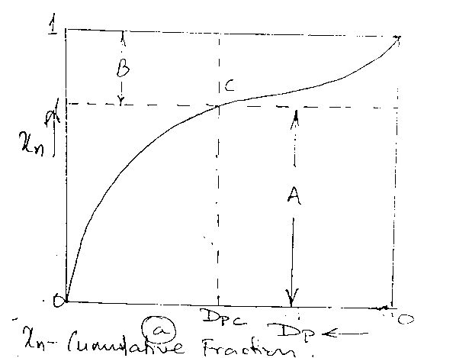
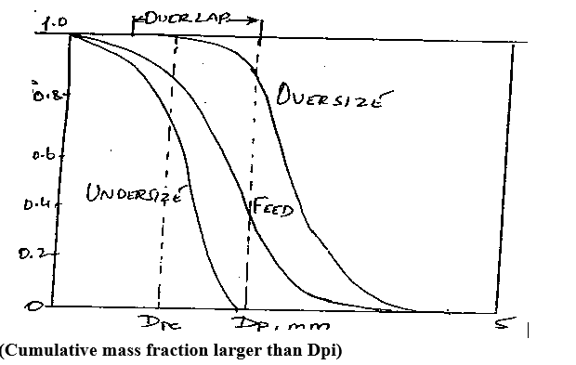
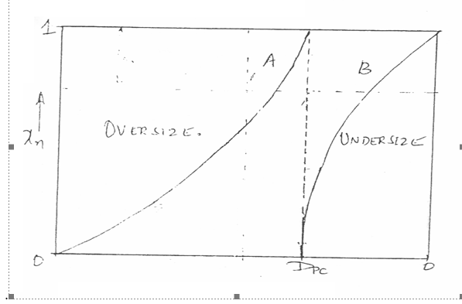
RV College of
Engineering
Go, change the world
IDEAL SCREENS
Actual Screens
C is the out put point
A: OverSize
B Undersize
No overlapping between the sizes

